Slide 1
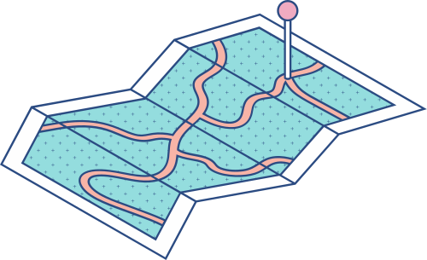





MAY 18, 2023
The Transactional Outbox pattern
Abdulrahman Alchammaa
1700004624

Slide 2


what is Transactional Outbox ?
The Transactional Outbox is a software design pattern that addresses the challenge of reliable and consistent message-driven communication within a distributed system. It is used to ensure that messages are delivered reliably to multiple components or services when a specific action or event occurs.

Slide 3
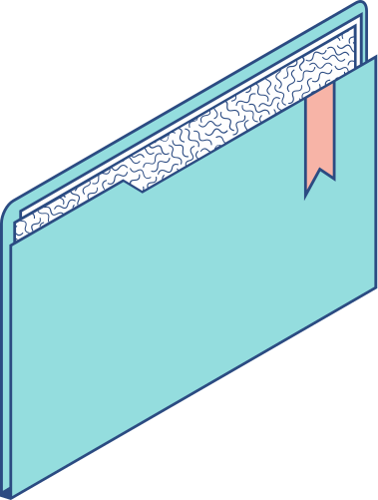
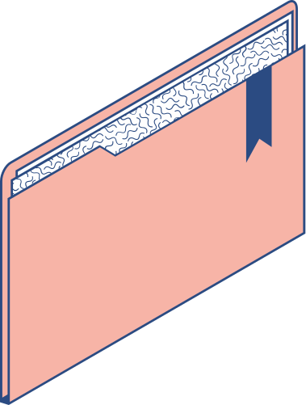

Today's Agenda
Aim of the pattern Implementation Pattern and their roles Software code & explanation

Slide 4

Aim of the pattern and implementation of Transactional Outbox
  To provide a reliable and scalable solution for handling message-driven communication between different components or services within a distributed system. It helps to ensure that messages are delivered reliably and that they are processed consistently.

Slide 5
Aim of the pattern and implementation of Transactional Outbox
  The Transactional Outbox pattern is often used in scenarios where multiple services need to be notified or updated when a particular action occurs in a system. Instead of directly sending messages to these services, the pattern employs an outbox table in the same database transaction as the business logic that triggers the messages. The outbox table acts as a buffer for outgoing messages.

Slide 6

Here's an overview of the pattern and its implementation:
Business Transaction Outbox Table Transactional Insert Message Dispatcher Message Delivery Outbox Cleanup

Slide 7
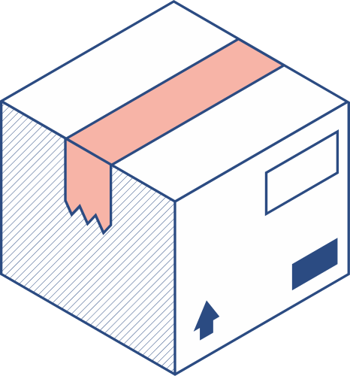


Business Transaction: | Outbox Table:
The pattern is typically used in the context of a business transaction. When a transactional operation occurs within a service or application, such as updating a database record, the relevant information for message generation is captured. | Alongside the business transaction, an outbox table is maintained in the same database. This table acts as a persistent store for outgoing messages. It contains the necessary information to construct the messages, such as message content, destination, and metadata.

Slide 8
Message Dispatcher: | Message Delivery:
A separate component, known as the Message Dispatcher, periodically polls the outbox table to check for new messages. It retrieves the pending messages and sends them to their intended destinations. The dispatcher can be a standalone service or part of an existing service, responsible for sending messages asynchronously. | The Message Dispatcher ensures reliable message delivery by employing appropriate mechanisms such as retries, acknowledgments, and error handling. It communicates with the external services or message brokers to send the messages securely and reliably.

Slide 9
Transactional Insert: | Outbox Cleanup:
During the database transaction, a new row is inserted into the outbox table, representing the outgoing message. The message is constructed based on the relevant information from the business transaction. | Once a message has been successfully dispatched, it can be marked as processed or deleted from the outbox table to prevent duplicate processing. Alternatively, a separate cleanup process can periodically remove processed messages from the table.

Slide 10
Message Dispatcher:
which periodically polls the outbox table to retrieve pending messages. the dispatcher is responsible for sending the messages asynchronously to their intended destinations.
Message Delivery:
to ensure reliable message delivery, such as retries, acknowledgments, and error handling. Highlight that the dispatcher communicates with external services or message brokers to send the messages securely and reliably.
Outbox Cleanup﻿:
messages can be marked as such or deleted from the outbox table to prevent duplicate processing. a separate cleanup process can periodically remove processed messages.
Pattern Components: Describe the key components of the Transactional Outbox pattern and their roles:

Slide 11
Business﻿ Transaction:
Explain that the pattern is used in the context of a business transaction, where a particular operation triggers the need for message generation.
Outbox Tabl﻿e:
Acts as a persistent store for outgoing messages. Contains the necessary information for constructing messages, such as content, destination, and metadata.
Transactional Insert:
A new row is inserted into the outbox table to represent the outgoing message. this insertion is done within the same database transaction as the business logic.
Pattern Components: Describe the key components of the Transactional Outbox pattern and their roles:

Slide 12
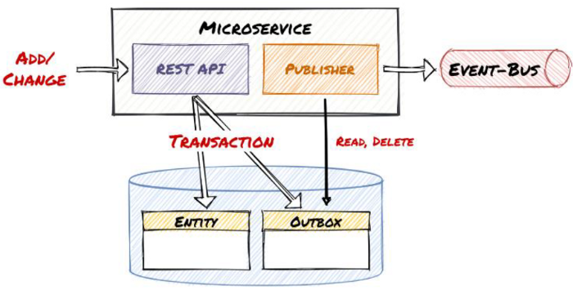

Slide 13
MAY 18, 2023
THANK YOU FOR LISTENING
Abdulrahman Alchammaa
1700004624

